Slide 1



Water Quality Prediction
Shivam Kumar
Student ID :-STU6831a606923bc1748084230

Slide 2

Learning Objectives
Understand how machine learning models can predict environmental pollutants.
Learn data preprocessing, feature engineering, and model deployment.
Gain hands-on experience with real-world datasets.
Apply regression techniques to predict pollutant levels based on year and station ID.
Practice deploying ML models in a web application.
GOAL
Source :
www.freepik.com/

Slide 3
Tools and Technology used
Programming Language: Python
Libraries: pandas, numpy, scikit-learn, joblib, pickle
Web Framework: Streamlit
Data Source: Water quality data CSV
Model Deployment: Local Streamlit web app

Slide 4
Methodology
Data Collection - Collected water quality data containing yearly pollutant measures.
Data Preprocessing – Cleaned data , handled missing value, and performed future encoding.
Model Selection - Chose RandomForestRegressor wrapped in MultiOutputRegressor for predicting multiple pollutants levels simultaneously.
Training – Trained ML model to predict pollutants like O2,NO3,NO2,SO4,PO4, and CL.
Evaluate the model - Validated performance using appropriate regression metrics.
Local Deployment - Built a Streamlit app for user input and prediction.

Slide 5
Problem Statement:
The core problem addressed was the need to predict various water pollutant levels (O2, NO3, NO2, SO4, PO4, CL) based on readily available information such as the year and specific station ID. Current methods might be time-consuming or lack predictive capabilities, making it difficult to anticipate water quality issues and manage environmental health proactively.

Slide 6
Solution:
The solution developed is a Water Pollutants Predictor web application, built using Python and Streamlit, powered by a trained machine learning model. This application allows users to:
Input a specific Year and Station ID.
Receive predicted pollutants Levels for that station and year in an easy-to-understand format.
The backend utilizes a MultiOutputRegressor(specifically) RandomForestResgressor trained on historical water quality data. The Streamlit interface provides a user-friendly way to interact with the model, transforming complex data analysis into a simple prediction tool.
GitHub Link - https://github.com/cybershivaa/WaterQualityPrediction

Slide 7
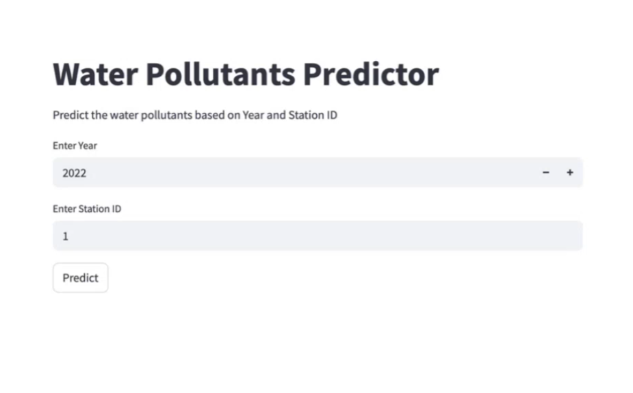
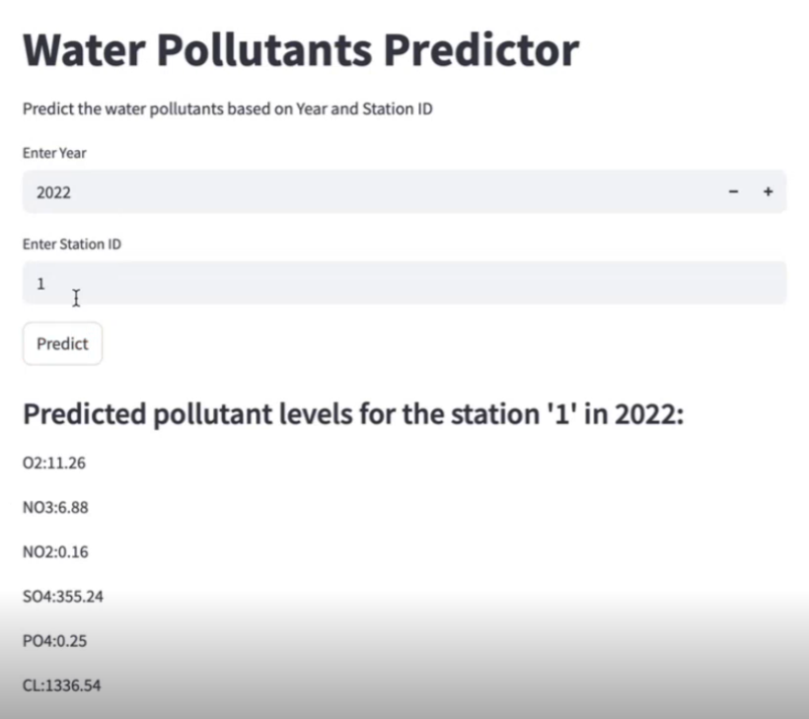
Screenshot of Output:

Slide 8
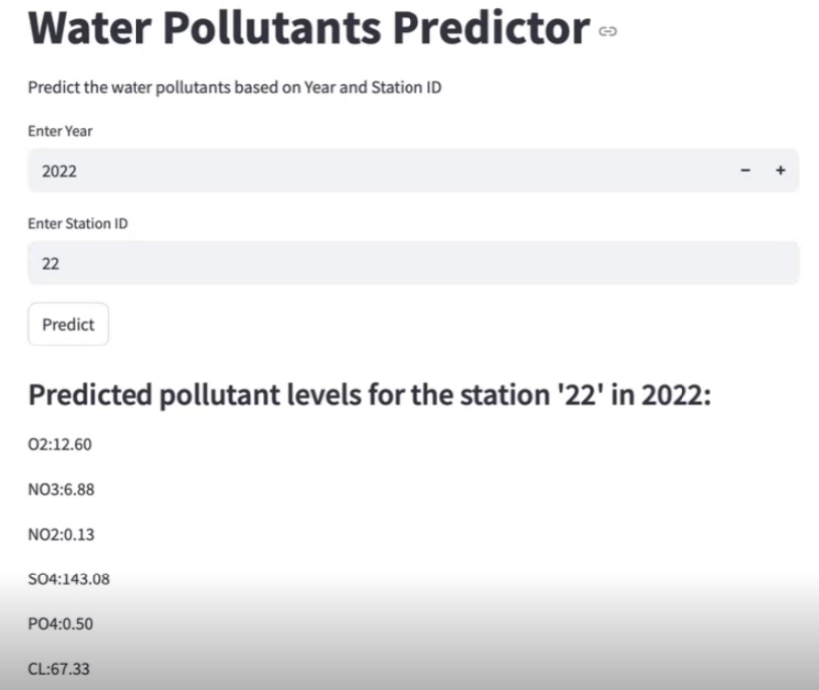
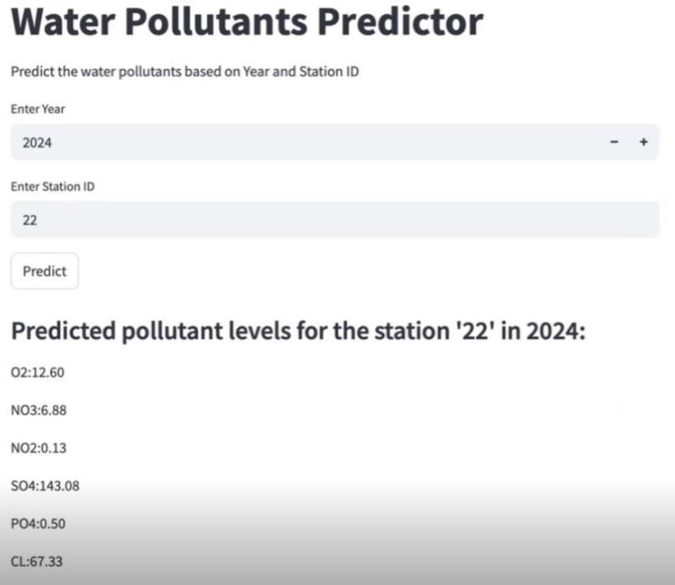
Screenshot of Output:

Slide 9
Conclusion:
This internship provided invaluable hands-on experience in the end-to-end development of a machine learning application, from data handling and model training to deployment. The Water Quality Prediction project successfully demonstrated how machine learning can be leveraged to address real-world environmental challenges, specifically in predicting water pollutant levels. This not only enhanced technical skills in Python, data science libraries, and web framework deployment but also deepened the understanding of the practical implications of AI in environmental monitoring. The ability to build an interactive tool that provides actionable insights from complex data is a significant outcome of this experience.
Successfully built and deployed a predictive model for water pollutants.
Learned practical implementation of end-to-end ML lifecycle.
Created a user-friendly interface using Streamlit.
This project enables proactive monitoring of water quality and supports environmental decision-making.
GitHub Link - https://github.com/cybershivaa/WaterQualityPrediction

